Slide 1
Strings and List in Python

Slide 2
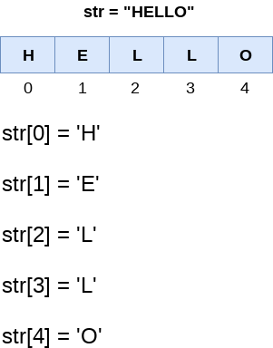
Strings in Python can be created using single quotes or double quotes or even triple quotes.
Strings indexing and splitting
Like other languages, the indexing of the Python strings starts from 0. For example, The string "HELLO" is indexed as given in the below figure.

Slide 3
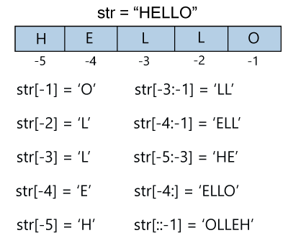

Slide 4
Strings are immutable in Python.
str = "HELLO"
str[0] = "h"
print(str)
//This gives error
Deleting the String
As we know that strings are immutable. We cannot delete or remove the characters from the string. But we can delete the entire string using the del keyword.
str1 = "JAVATPOINT"
del str1
print(str1)

Slide 5
Escape Sequence
The backslash(\) symbol denotes the escape sequence. The backslash can be followed by a special character and it is interpreted differently.

Slide 6
Python List
A list in Python is used to store the sequence of various types of data. Python lists are mutable, which means we can modify its element after it is created.
A list can be defined as a collection of values or items of different types. The items in the list are separated with the comma (,) and enclosed within square brackets [].
The list has the following characteristics:
The lists are ordered.
The element of the list can be accessed by index.
The lists are mutable.

Slide 7
List indexing and splitting
The indexing is processed in the same way as it happens with the strings. The elements of the list can be accessed by using the slice operator
The index starts from 0. The first element of the list is stored at the 0th index, the second element of the list is stored at the 1st index, and so on.
Python provides the flexibility to use the negative indexing also. The negative indices are counted from the right. The last element (rightmost) of the list has the index -1; its adjacent left element is present at the index -2 and so on until the left-most elements are encountered.

Slide 8
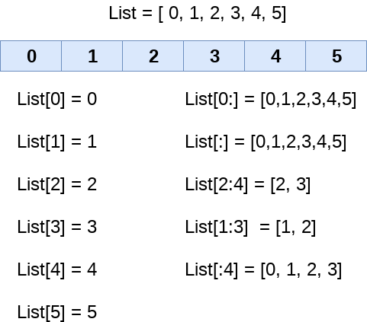

Slide 9
Updating List values
Lists are the most versatile data structures in Python since they are mutable, and their values can be updated by using the slice and assignment operator.
Python also provides append(),extend() and insert() methods, which can be used to add values to the list.

